Slide 1
swt practice

Slide 2
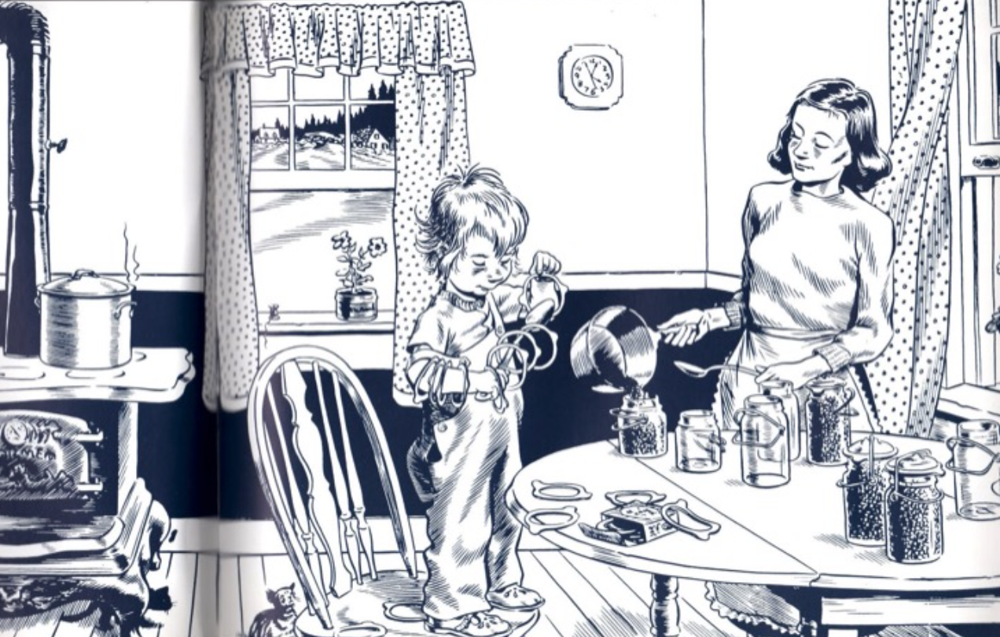
Notes:
Add credits

Slide 3
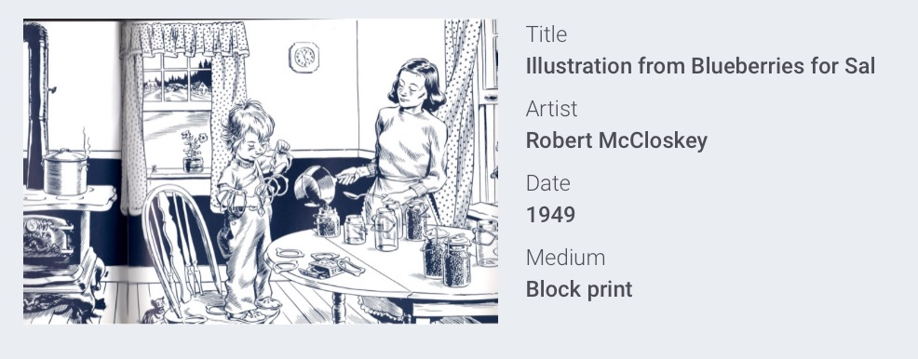

Slide 5
NY Times Visual Thinking Series
Tinatin Kiguradze, photographer.
The original caption reads:
One of dozens of animals to have escaped amid flooding in the main zoo in Tbilisi, Georgia (Russia) a hippopotamus was coaxed away from dangerous waters on Sunday.

Slide 6
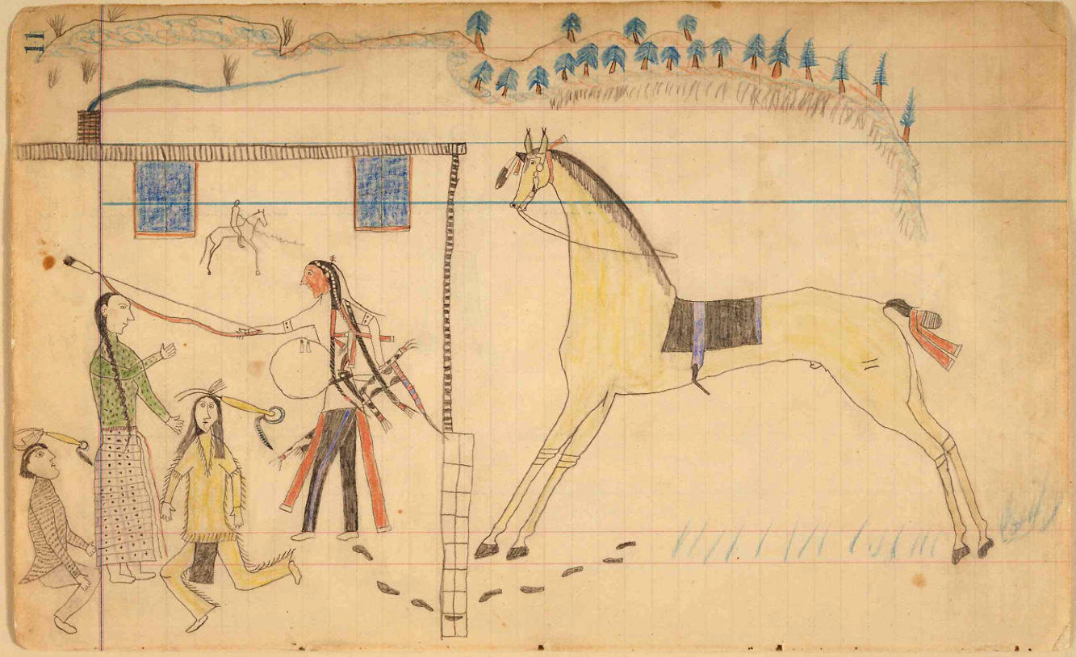

Slide 8
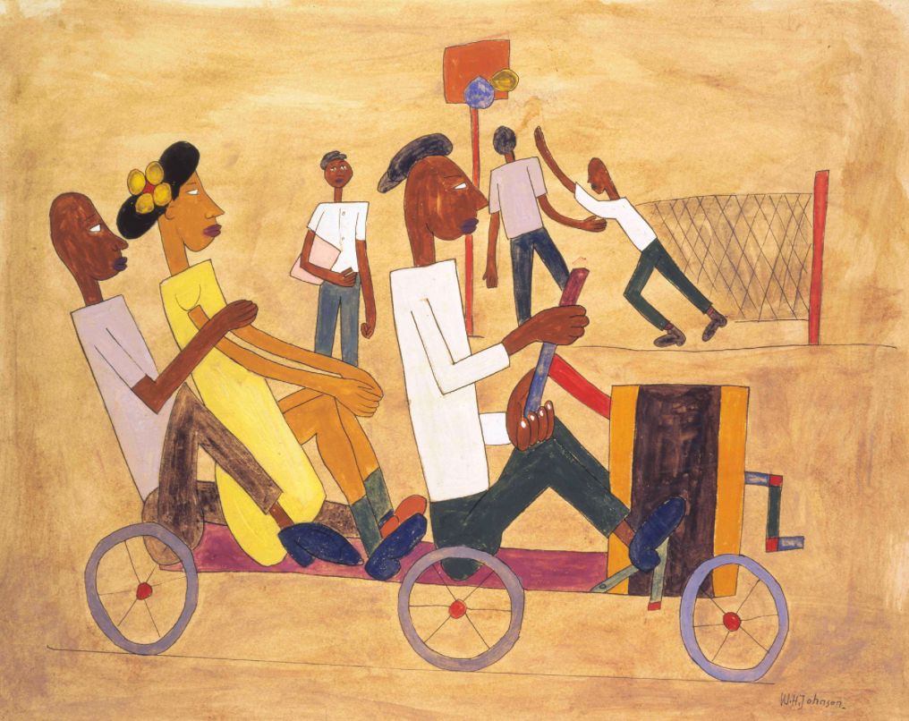

Slide 9
