Slide 1
Jumping into art
A perspective taking strategy to increase engagement, & comprehension and make inferences.

Slide 2
Winslow Homer
The Gulf Stream
1899

Slide 3
1 Interviewer (teacher)
2 Actor

Slide 4
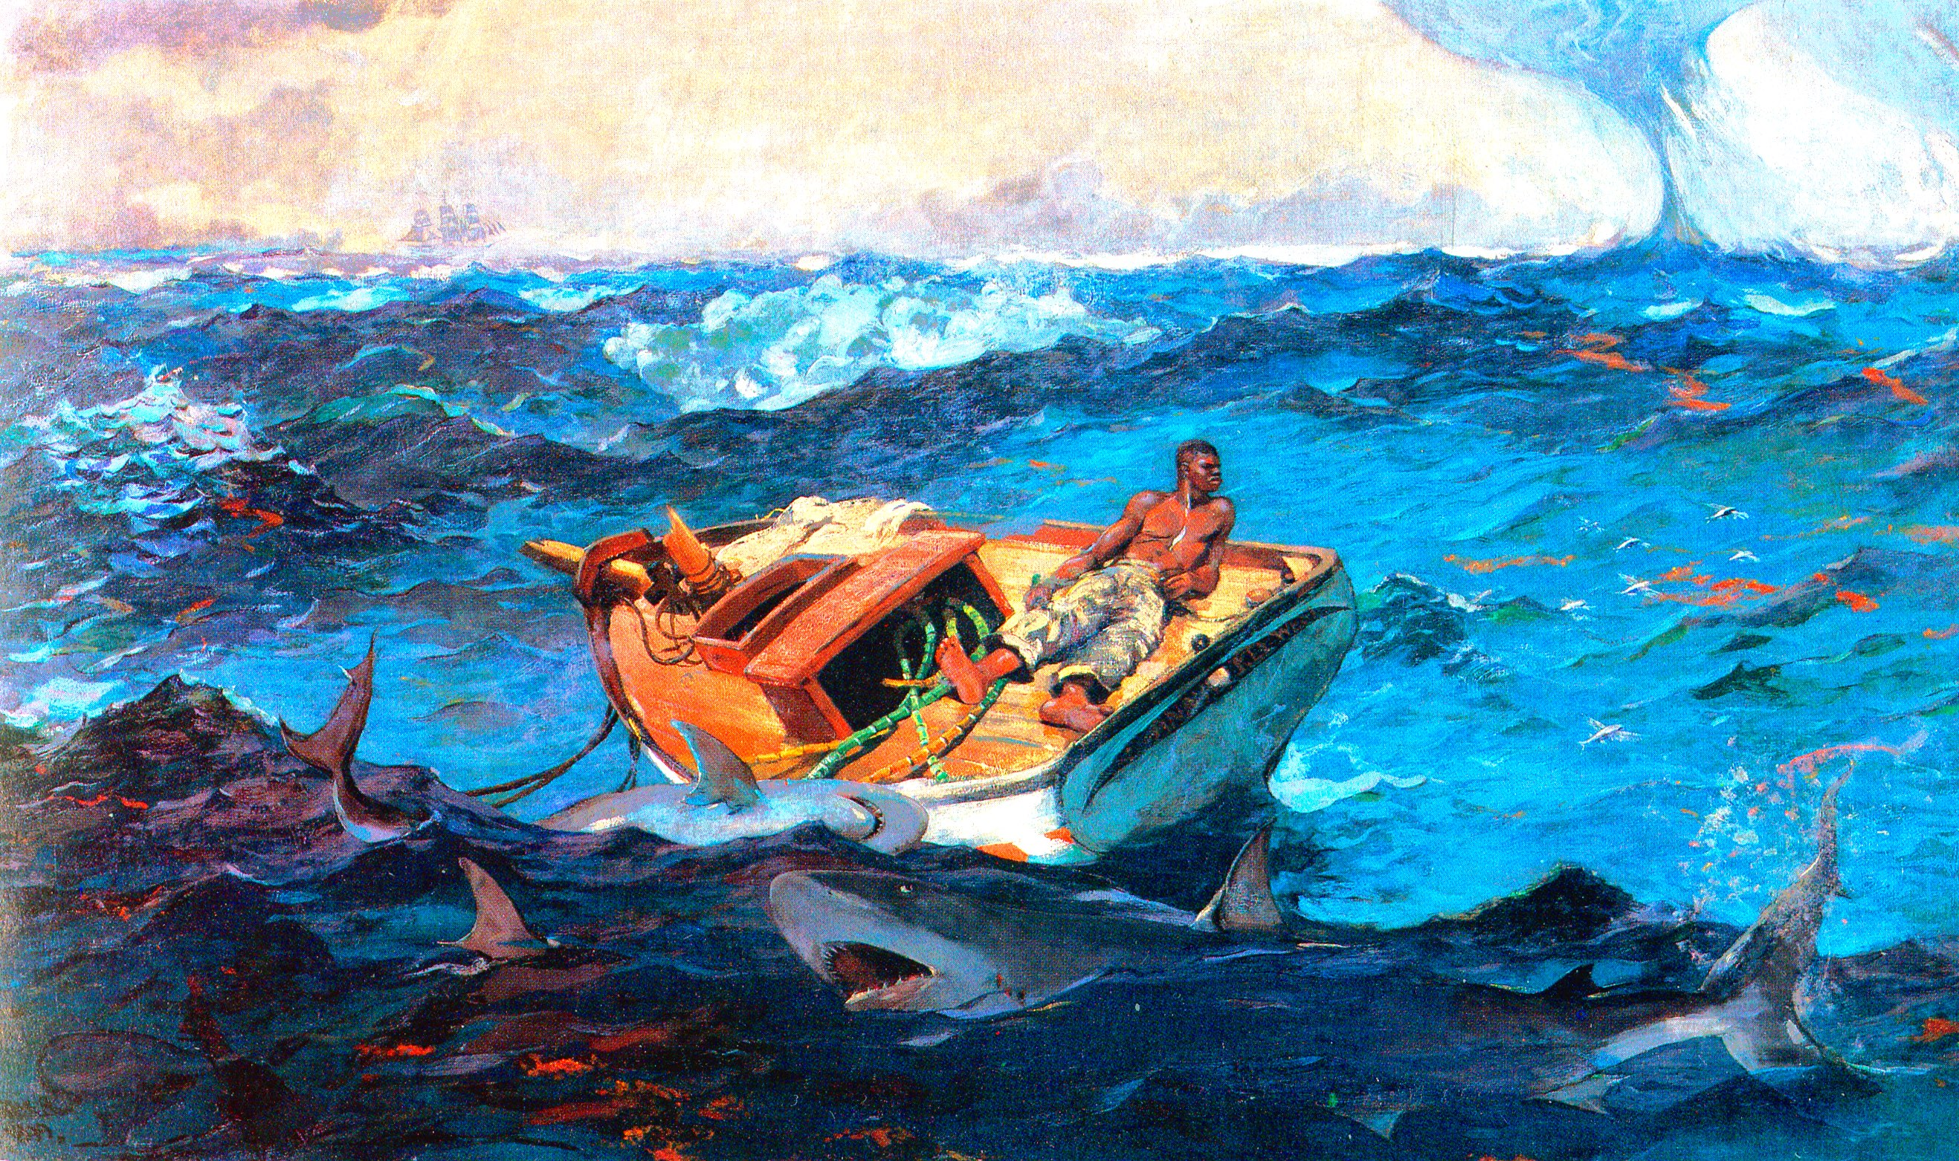
1. Senses
2. Know
3. Care about

Slide 5
2 volunteers

Slide 6
Caps for Sale
Esphyr Slobodkina
1938

Slide 7
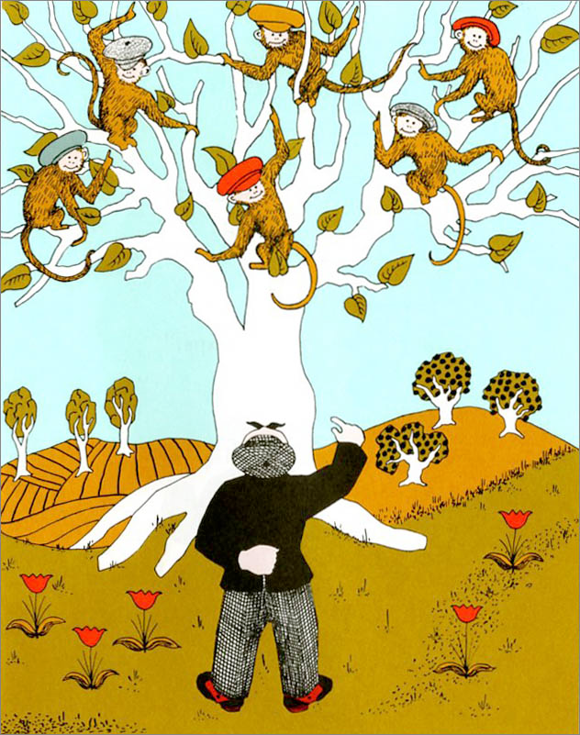
1. What happened here?
2. Feelings?
3. Prediction?

Slide 8
What to notice
Pantomime, expressing emotion, improvisation, gesture
Actor is actively engaged as part of the narrative rather than passive observer
Reading text closely
Making inferences

Slide 9
Form trios, please

Slide 10
1 Interviewer
2 Sal
3 Bear

Slide 11
Blueberries for Sal
Robert McCloskey
1948

Slide 12
Summary so far

Slide 13
Senses
Know
Care about
What happened (BME)
Feelings
Prediction

Slide 14
Variety of texts

Slide 15
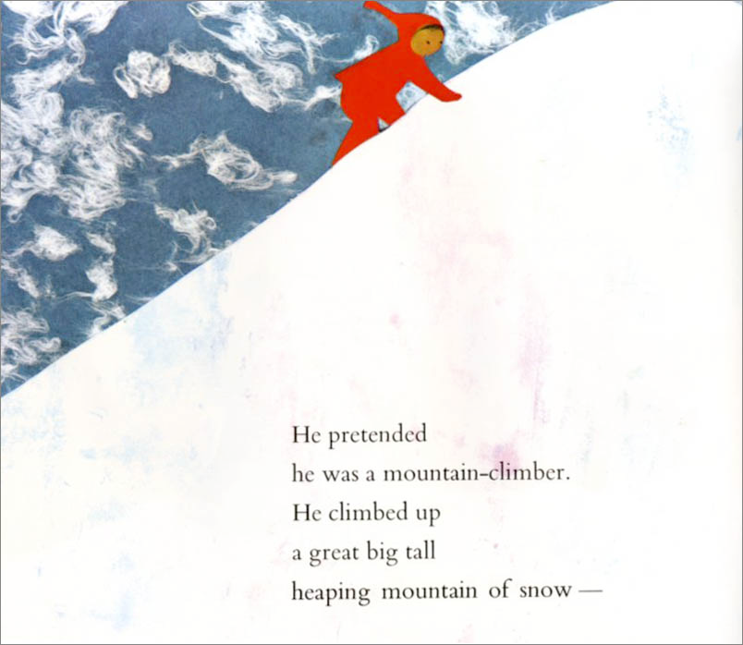
The Snowy Day
Ezra Jack Keats
1962

Slide 16
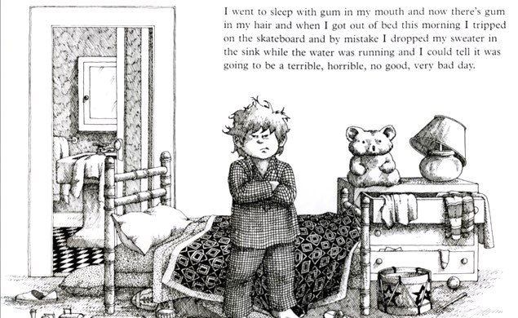
Alexander and the Terrible, Horrible, No Good, Very Bad Day
illustrated by Ray Cruz
1972

Slide 17
A Baby Sister for Frances
Russell Hoban
1976

Slide 18
Harold and the Purple Crayon
Crockett Johnson
1955

Slide 19
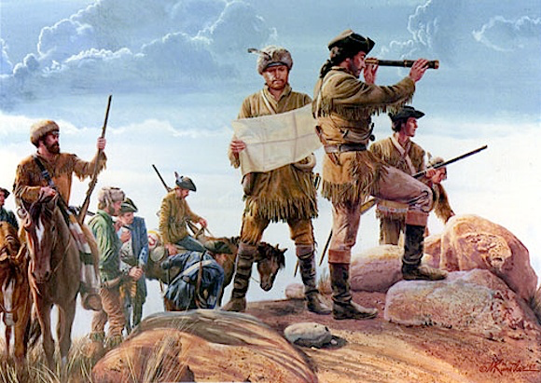

Slide 20
VAPA: Grade 1
2.0 CREATIVE EXPRESSION
Creating, Performing, and Participating in Theatre
Development of Theatrical Skills
• 2.1 Demonstrate skills in pantomime, tableau, and improvisation.
Creation/Invention in Theatre
• 2.2 Dramatize or improvise familiar simple stories from classroom literature or life experiences, incorporating plot (beginning, middle, and end) and using a tableau or a pantomime.

Slide 21
Reading Anchor Standards
1. Read closely to determine what the text says explicitly and to make logical inferences from it; cite specific textual evidence when writing or speaking to support conclusions drawn from the text.
3. Analyze how and why individuals, events, or ideas develop and interact over the course of a text.

Slide 22
Speaking/ Listening
Anchor Standards
1. Prepare for and participate effectively in a range of conversations and collaborations with diverse partners, building on others' ideas…
4. Present information and supporting evidence such that listeners can follow the line of reasoning…
6. Adapt speech to a variety of contexts…

