Slide 1
Back at 2:10

Slide 2
Technology
Why training is tricky…

Slide 3
If technology is the answer, what is the question?

Slide 4
SAMR

Slide 5
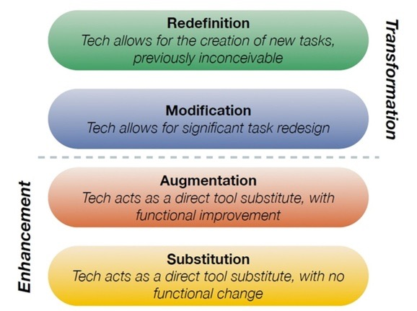

Slide 6
SAMR example: writing
Write story collaboratively with students from another country. Create and share publicly.
Redefinition
Write story, add audio reading, images (Adobe Voice, for example)
Modification
Use spell check, thesaurus, speech to text
Augmentation
Substitution
Use word processor

Slide 7
Mirroring tablet
Mobile visual presenter!

Slide 8
Where can you get images?
_____________(concept) + “painting” or “sculpture”
Google search tips
Calisphere for California history documents/ photos
nytimes.com has weekly “What’s going on in this picture?” series
getty.edu & google art project display art at amazing resolution
H

Slide 9
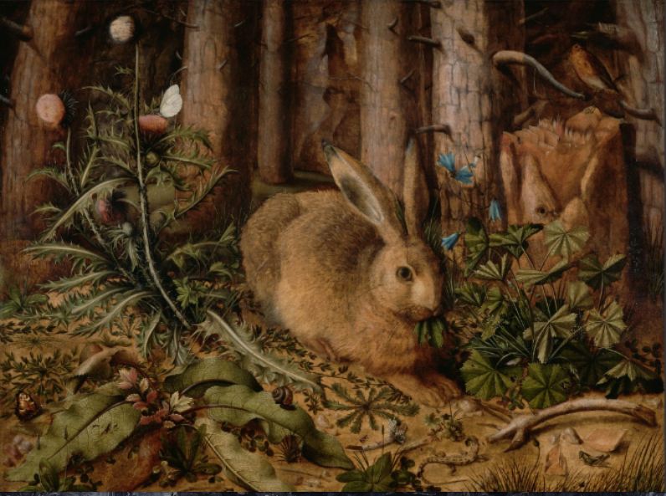
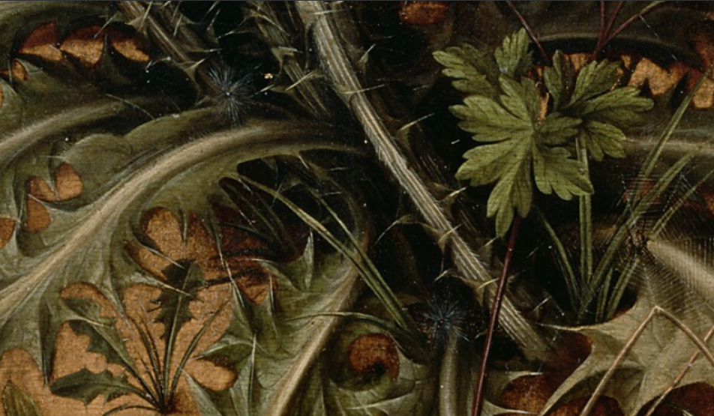

Slide 10
Google goggles video

Slide 12
Blendspace

Slide 13
HaikuDeck
Example

Slide 14
QR Codes Reader
Google Goggles (android)
Red Laser (iOS)

Slide 15
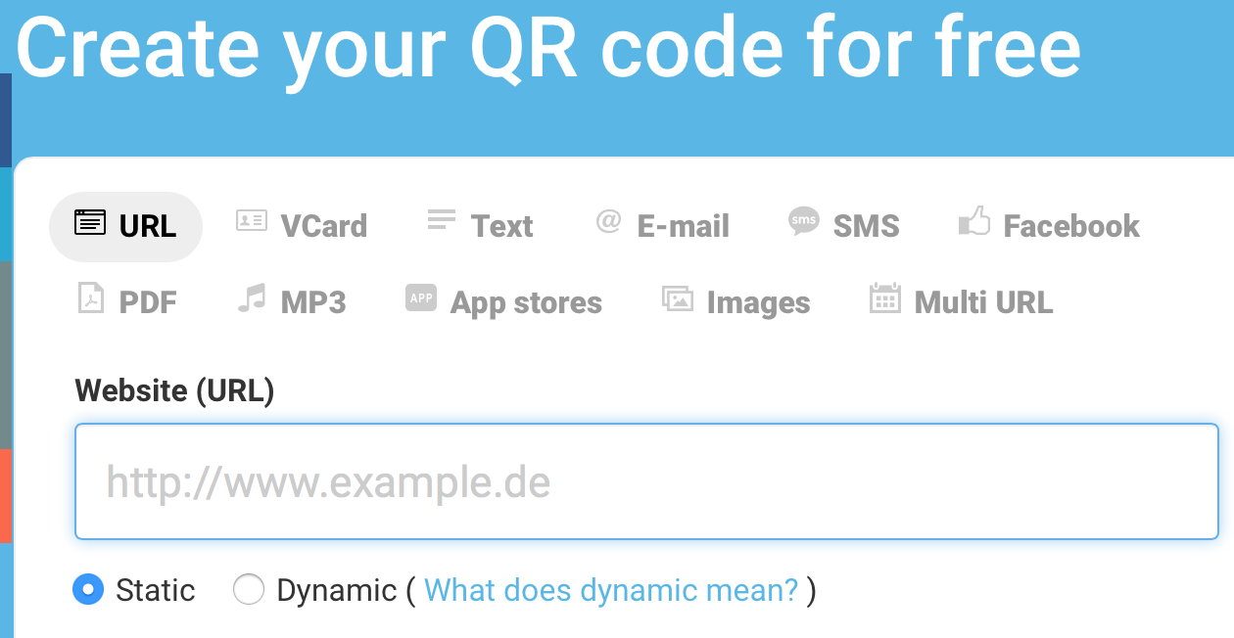
QR Codes Creator

Slide 16
Your turn
Mirroring your tablet
Using Google search tools
Calisphere, Google art project, NY Times, Getty
Google goggles
Blendspace
Haiku Deck

