Slide 1
Beginning,
Middle or End?
B

Slide 2
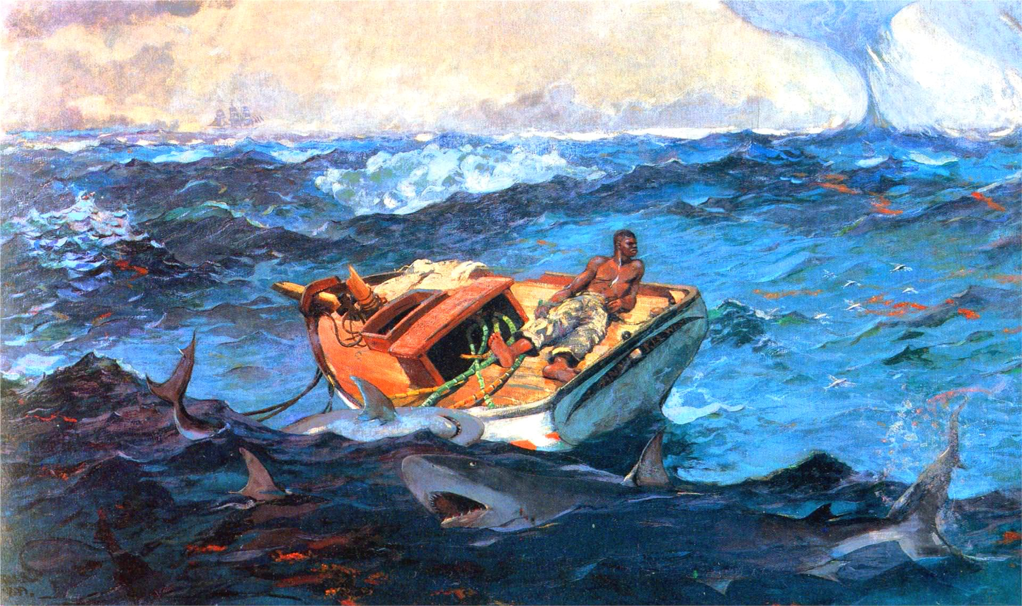
Need

Slide 3
Beginning, Middle, End
If this is the beginning of a story, what happens next?
If this is the middle of the story, what happened before and after?
If this is the end of the story, what was the story about?
H

Slide 4
Look closely to complete the beginning, middle & end of this story that uses details you can point to.
H

Slide 5
Winslow Homer
“The Gulf Stream”
1899
B

Slide 6
Focus considerations
Setting
Plot
Character
Point of view/Perspective taking
Dialogue
Conflict
Theme

Slide 7
Look closely to fill in the
beginning, middle and end of this story
B

Slide 8
Gregory Crewdson
“Untitled”
1998-2002
B

Slide 10
Shawn Tan

